Slide 1
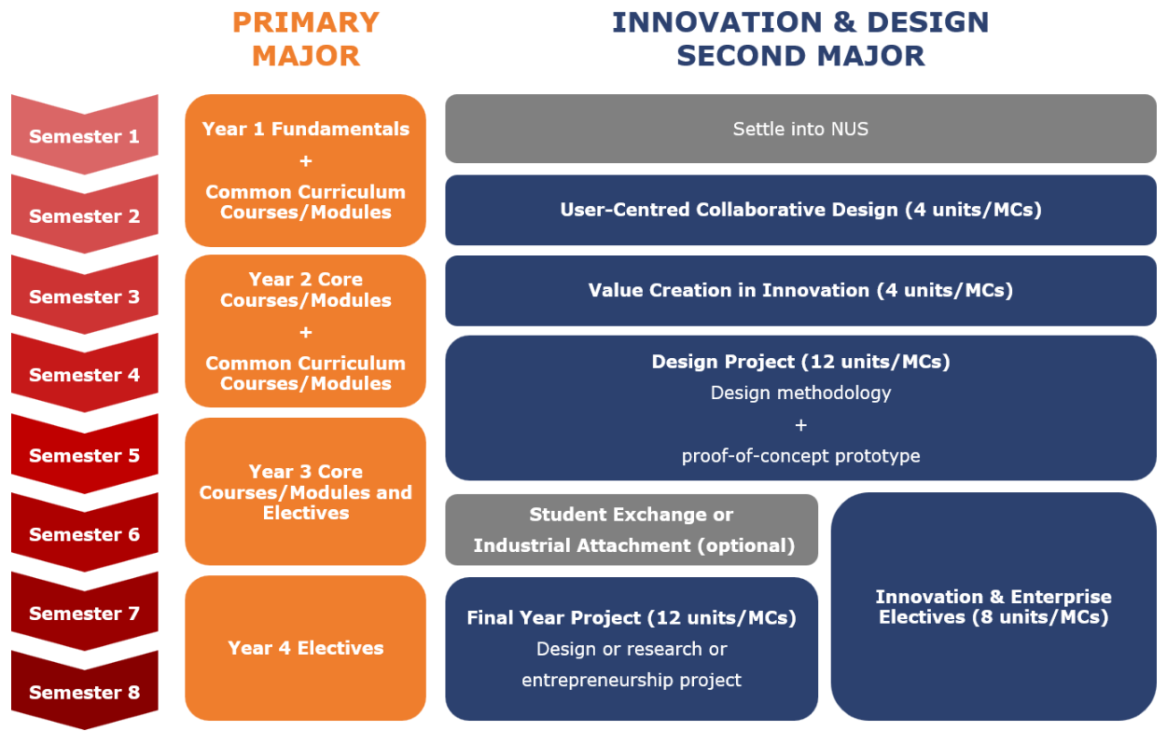
Second Major in Innovation & Design

Slide 2
Second Major in Innovation & Design
The Second Major in Innovation & Design consists of a series of project-based courses/modules that run throughout a student’s candidature. Students are expected to develop their knowledge, skills, and abilities in innovation and design in a cumulative manner through these courses/modules.
The learning journey begins with lower-level modules that introduce students to basic concepts in innovation and design, and culminates in a major design project and a final year project where students are expected to apply their design knowledge and skills to develop solutions to real problems. Students will also take a number of Innovation & Enterprise electives to widen their knowledge about topics in design, business, and entrepreneurship.

Slide 3
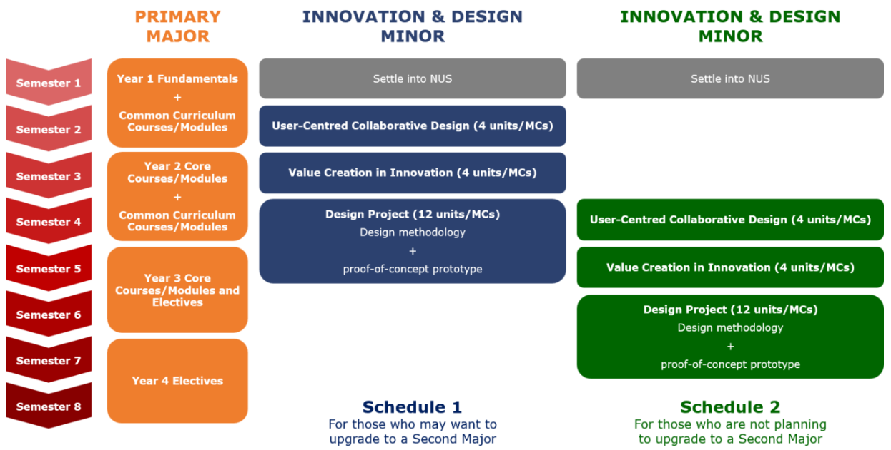
Minor in Innovation & Design

Slide 4
If you have any query, please contact us!
Contact information can be found at
https://cde.nus.edu.sg/edic/

